Slide 1
AI-Enhanced SECURING DATA HIDING IN IMAGES USING STEGANOGRAPHY
CAPSTONE PROJECT
Presented By
Student Name : Rithika Sadeesh
College Name : PANIMALAR ENGINEERING COLLEGE
DEPARTMENT : Artificial Intelligence and Machine Learning

Slide 2
OUTLINE
Problem Statement
Technology used
Wow factor
End users
Result
Conclusion
Git-hub Link
Future scope

Slide 3
Problem Statement
Manual image selection in steganography is inefficient and prone to human error.
Identifying an optimal image requires analyzing complex factors like texture and color distribution.
Lack of a standardized method leads to suboptimal data hiding and security risks.
A need exists for an automated approach to ensure optimal image selection for steganography.

Slide 4
Technology used
1. Programming Language:
Python 3.x – The core language used for AI, image processing, and steganography implementation.
2. Development Environment:
JUPYTER NOTEBOOK – An interactive environment for writing, testing, and visualizing Python code.
3. Machine Learning & AI:
TensorFlow – Used for training and deploying AI models to analyses images and optimize selection.
4. Image Processing:
OpenCV – Handles image preprocessing, feature extraction, and analysis (e.g., texture and colour distribution).
Scikit-Image – Provides advanced image processing tools for feature extraction and quality assessment.
5. Mathematical & Data Handling Libraries:
NumPy – Supports numerical computations, matrix operations, and efficient image data handling.

Slide 5
Wow factors
Seamless integration with Deep Learning
AI -Based Image Selection
Enhanced Security
Fully Automated & User Friendly

Slide 6
End users
Cybersecurity Professionals
Use it to securely hide sensitive data within images to prevent unauthorized access.
Government & Intelligence Agencies
Used for classified communications without raising suspicion.
Journalists & Whistleblowers
Enables secure communication and data transfer in regions with strict censorship.
Helps in hiding confidential information within innocuous images.
Researchers & Academicians
Useful in steganography, cryptography, and AI research.

Slide 7
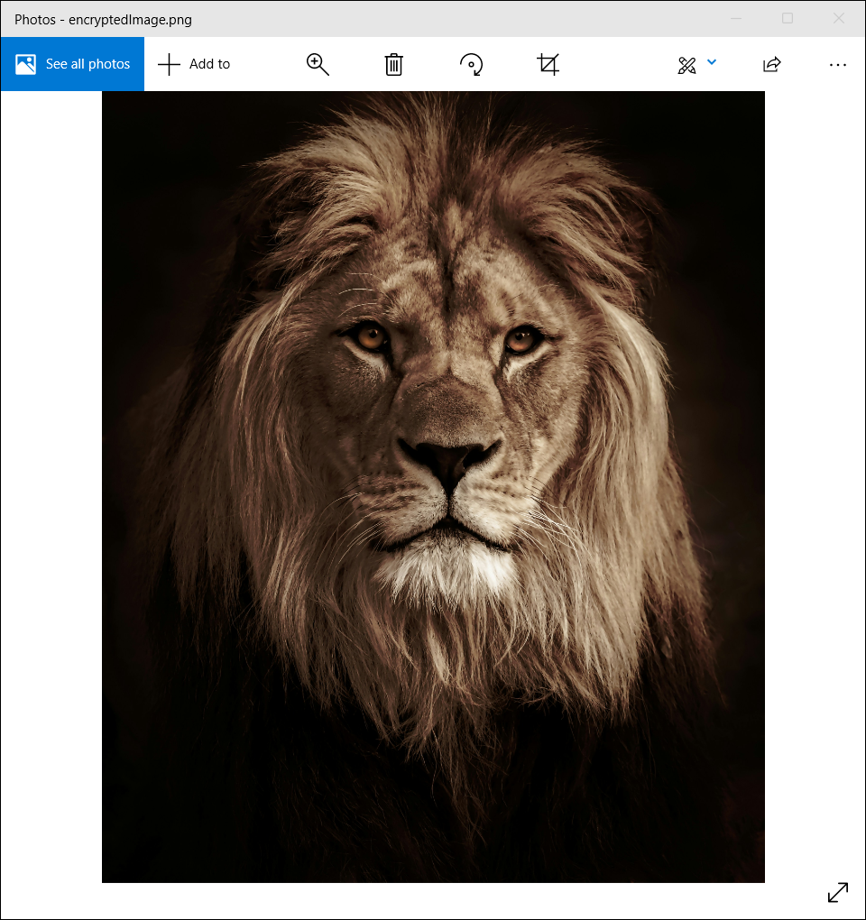
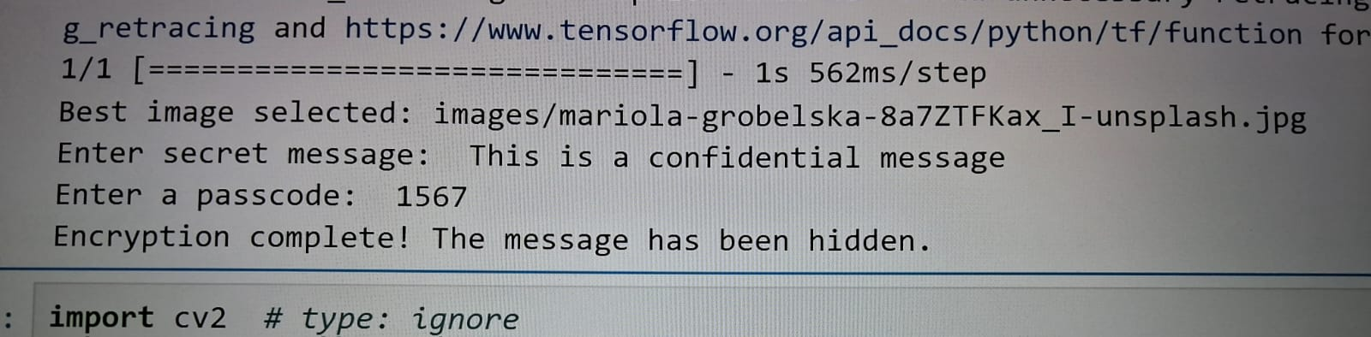
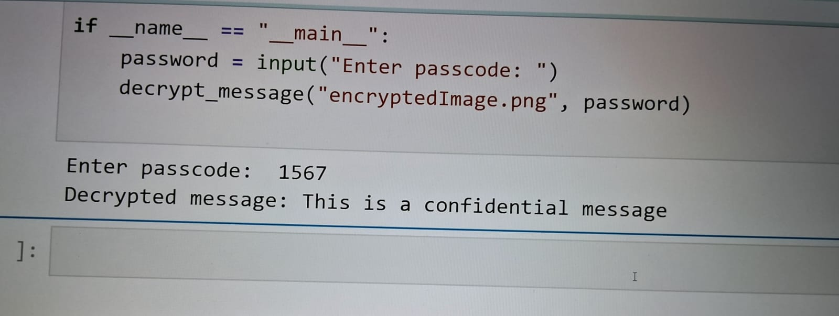
Results

Slide 8
Conclusion
Traditional steganography methods rely on manual image selection, which is inefficient, subjective, and prone to errors. The effectiveness of data hiding depends on factors like texture, color distribution, and complexity, making image selection a critical step. To address this challenge, AI-based automation ensures optimal image selection by analyzing key features, enhancing security, and improving embedding efficiency. This approach minimizes human intervention, optimizes data concealment, and provides a standardized method for selecting the best cover image, making steganography more reliable and effective.

Slide 9
GitHub Link
https://github.com/Rithika-tech-projects/Steganography

Slide 10
Future scope:
AI-Driven Adaptive Steganography – Developing AI models that dynamically select the best embedding techniques based on image characteristics.
Steganalysis Resistance – Enhancing security to make hidden data undetectable against advanced detection algorithms.
Cross-Media Steganography – Expanding AI-based steganography to audio, video, and 3D media for broader applications.

Slide 11
THANK YOU

